Slide 1

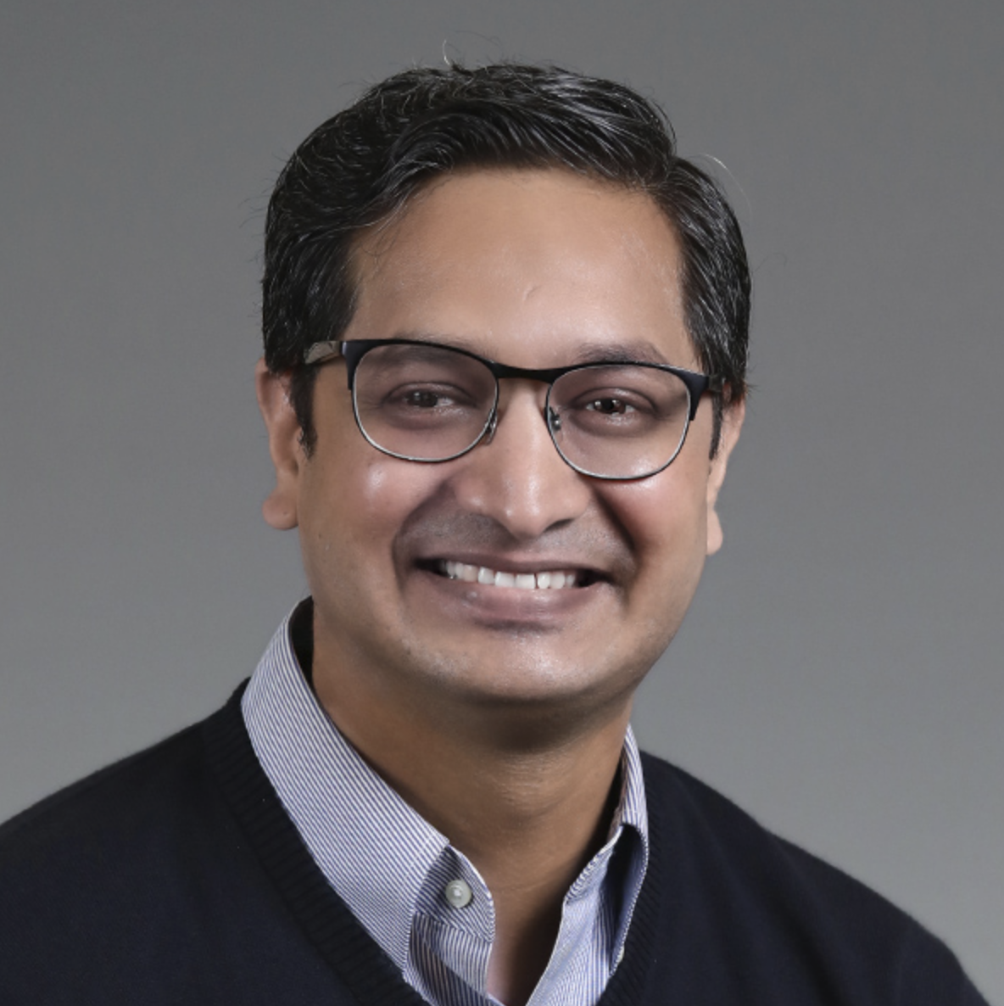
Workshop
Mastering Stable Diffusion
Module 1
Fundamentals of Diffusion Models
Sandeep Singh
Head of Applied AI, Beans AI

Slide 2

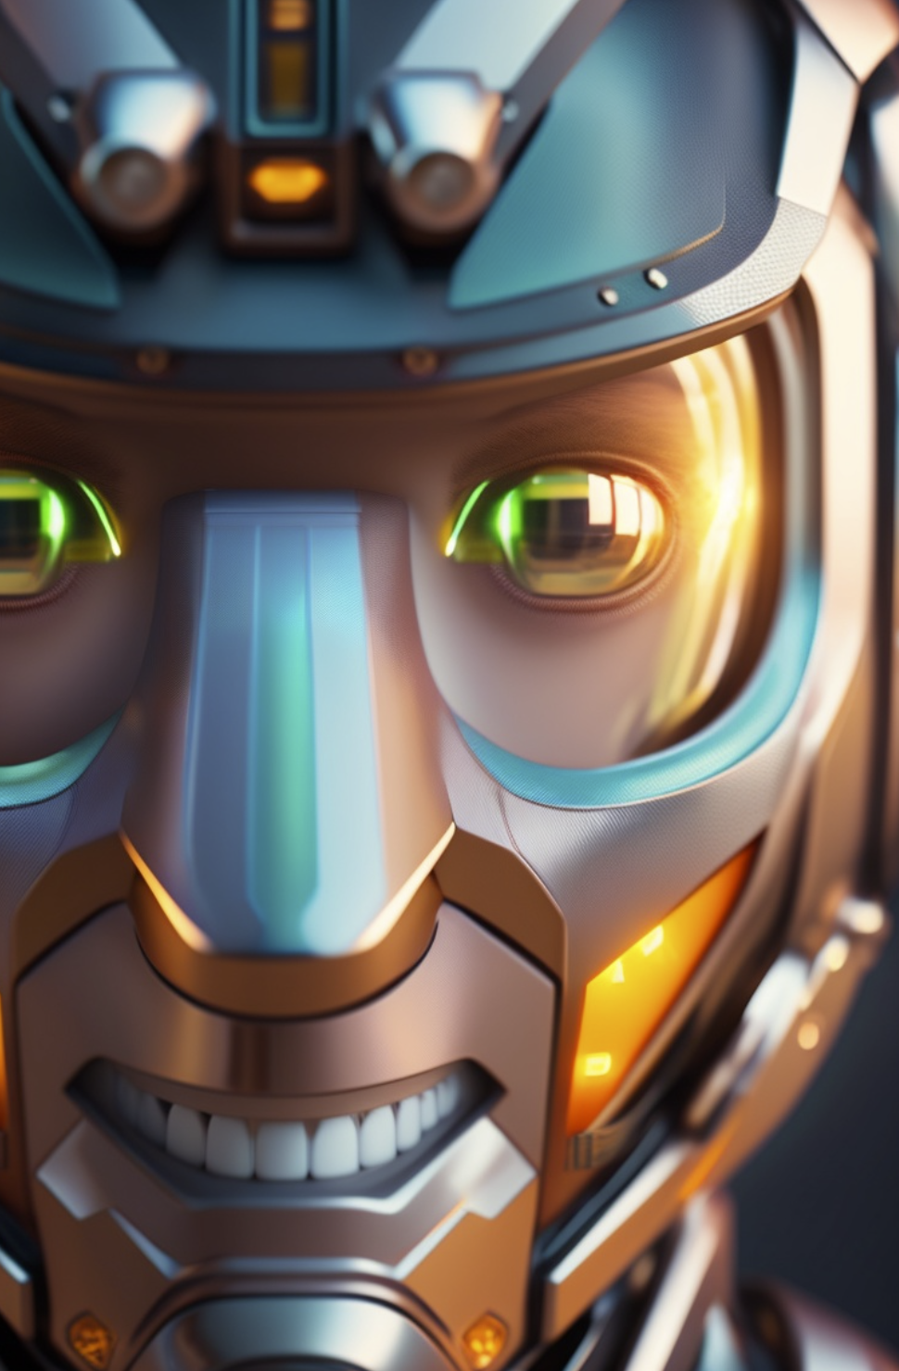
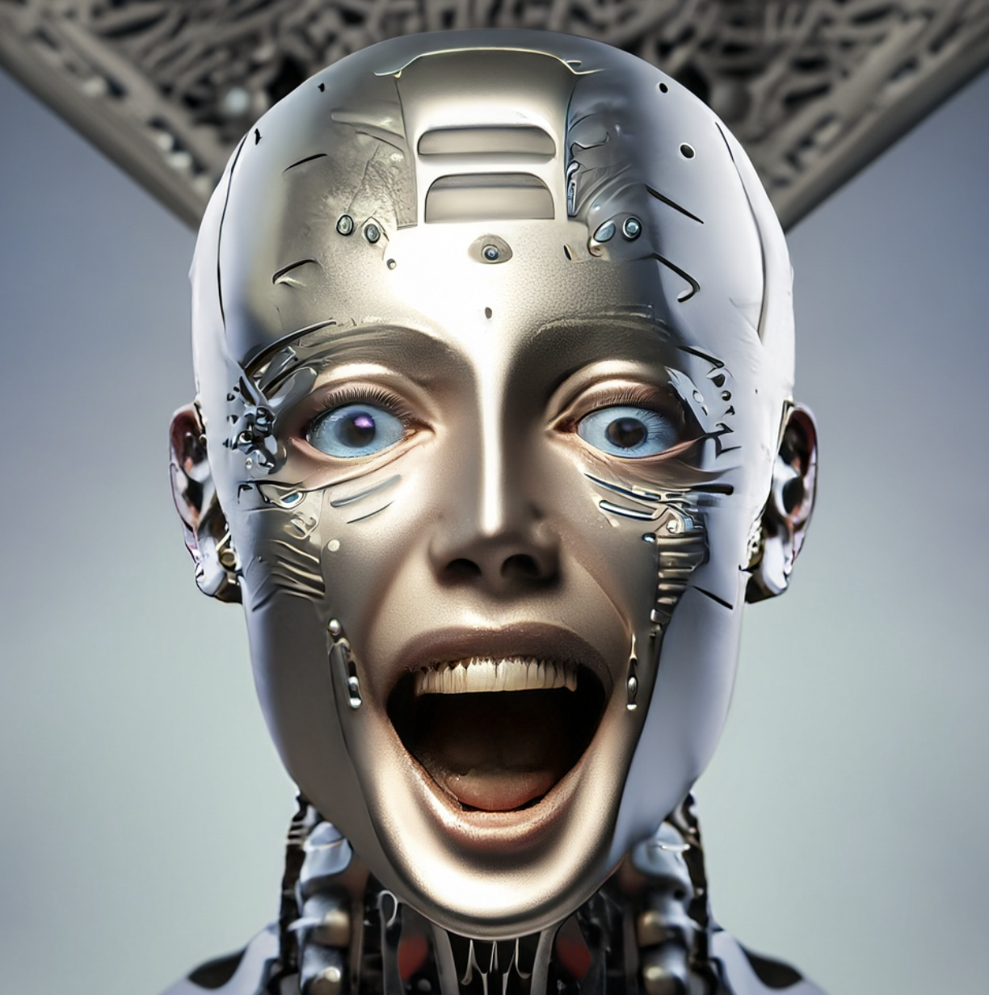
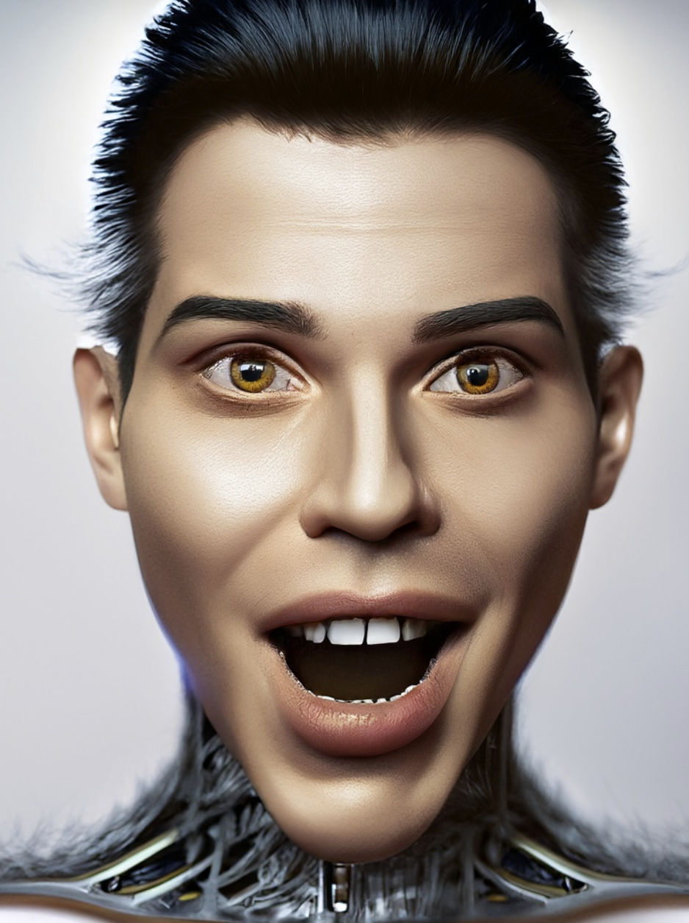
Excited?

Slide 3

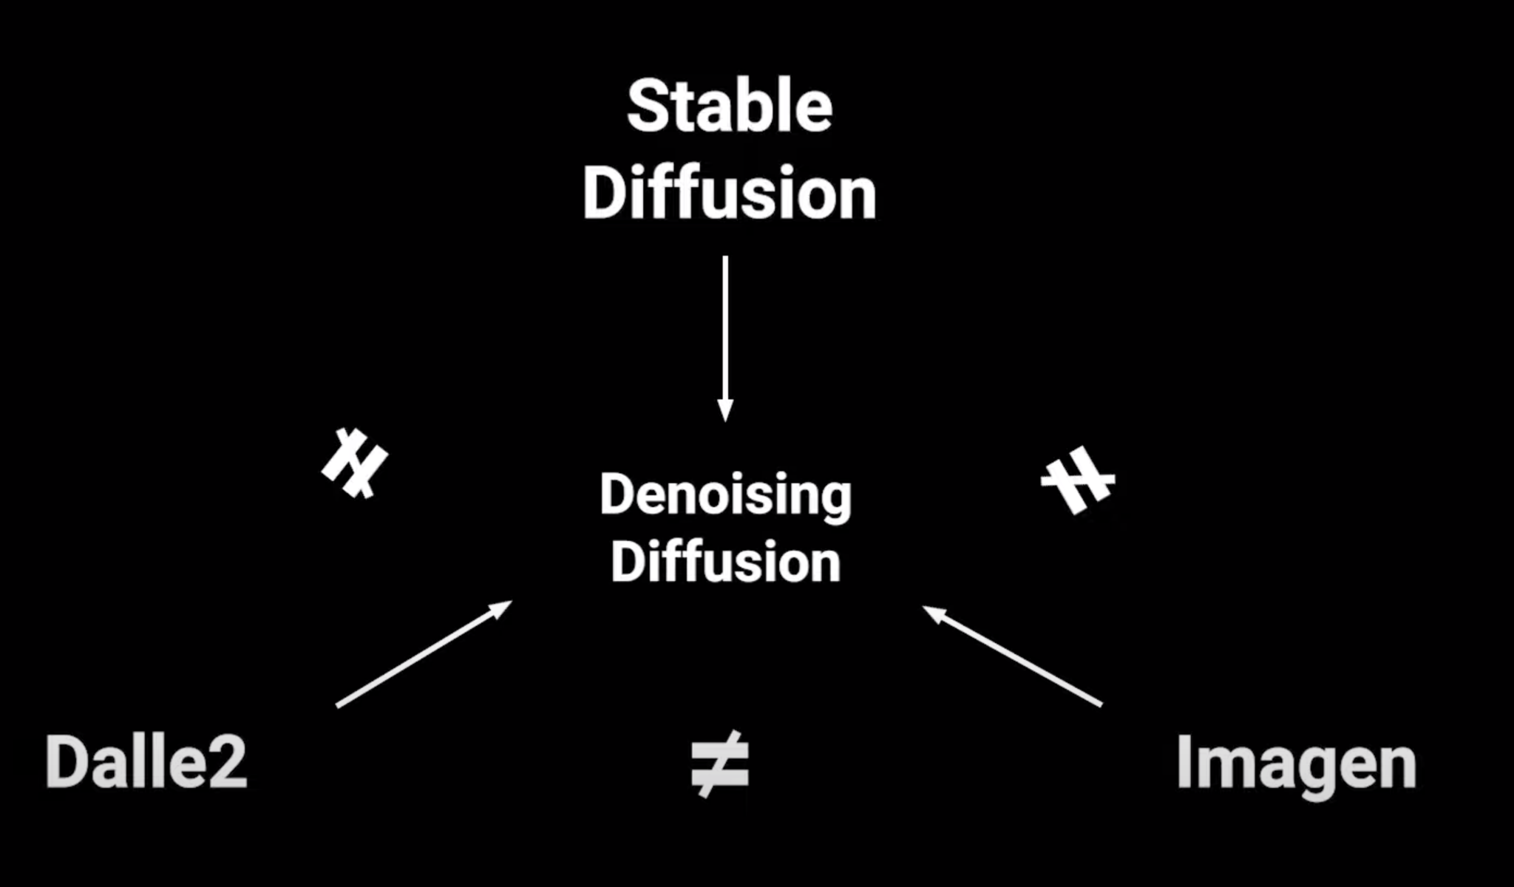
Stable Diffusion: Why Care?
Almost all Text-to-Image techniques are Inspired by This!
Poster Child of Text-to-Image Model.
First Open Source State of Art Diffusion Model.
Inspired by Physics of Fluids/Gases
Improved Image Reconstruction
Robustness to Variability, more resilient to changes in illumination, contrast
Enhanced Edge Preservation as in Image above.

Slide 4
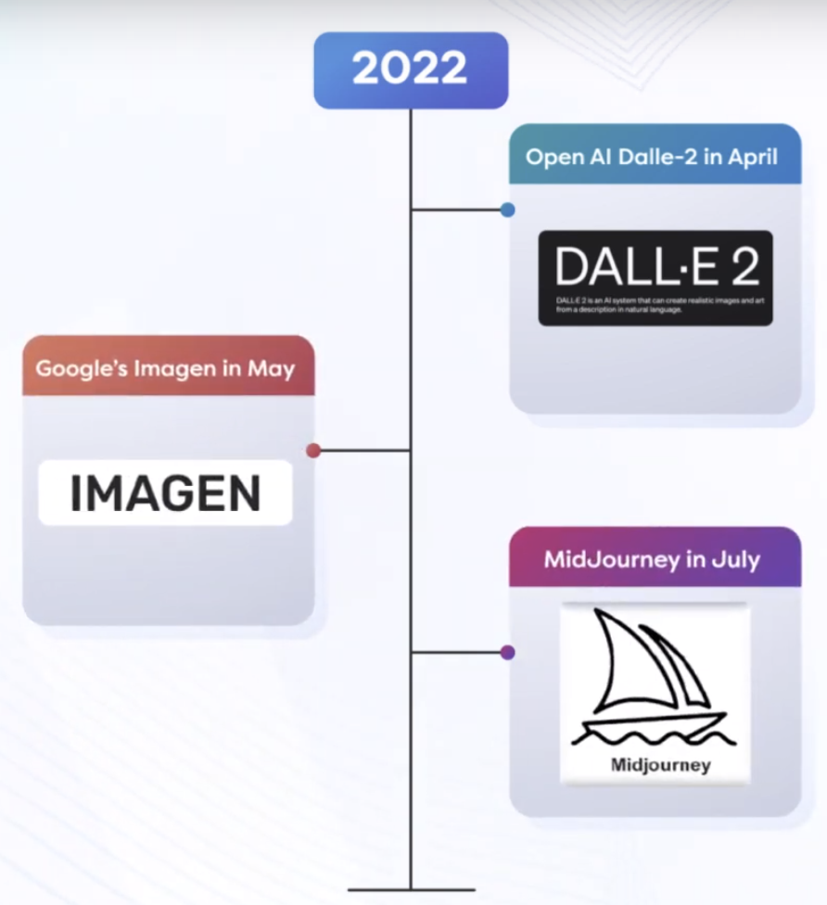
History of Stable Diffusion
Pre-Stable Diffusion Models Era
Text to Image models had amazing 2022
State of Art has been moved by Leaps and bounds.
OpenAI Released DallE-2 in April
Google Released Imagen in May
MidJourney released in July
Everything was wonderful, but Proprietary and Closed Source.
Researchers where left High and Dry
Community validation of methods was not available.
Fine-tuning these models was a not an easily available option if you are not a big AI Research Lab.

Slide 5
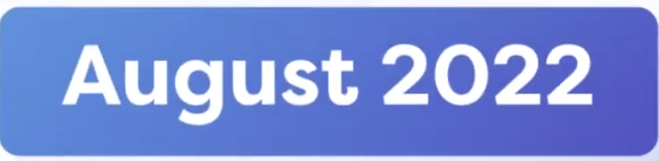
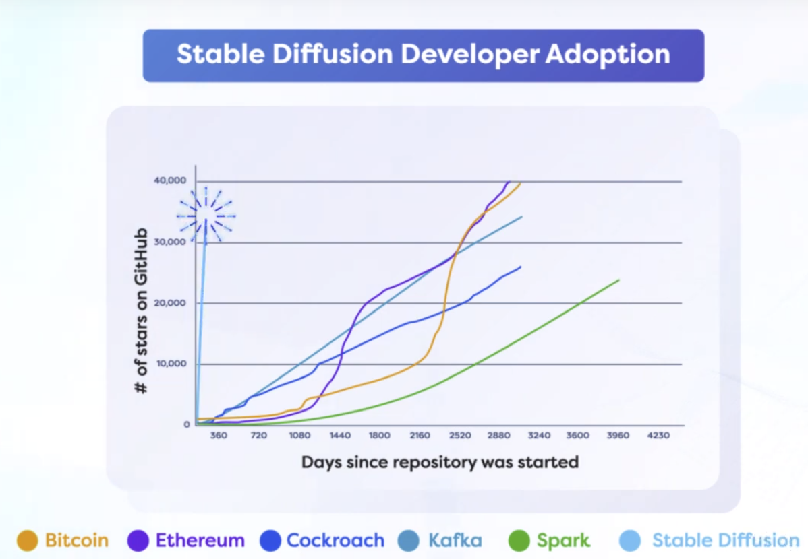
History of Stable Diffusion
Shining Star: Stable Diffusion
Stable Diffusion was released as:
Open Source Code and Model Weights
Took the Developers Community by Storm as fast growing Open Source project. 30K Stars on Github!
Simplistic and Beautiful Code and Diffusion Approach was at the center of excitement.
Most Important: Commodity Consumer Hardware was enough to finetune.

Slide 6

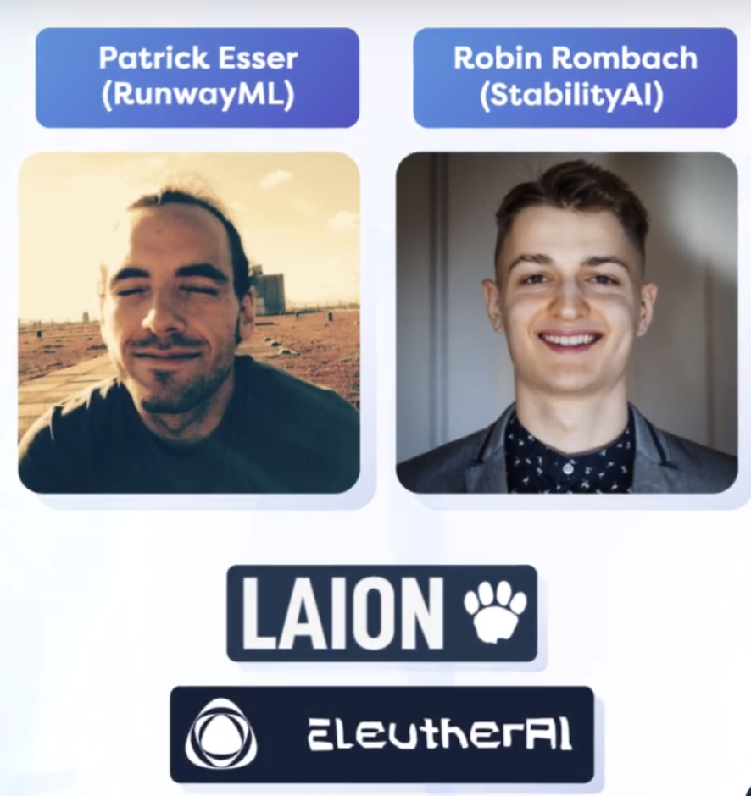
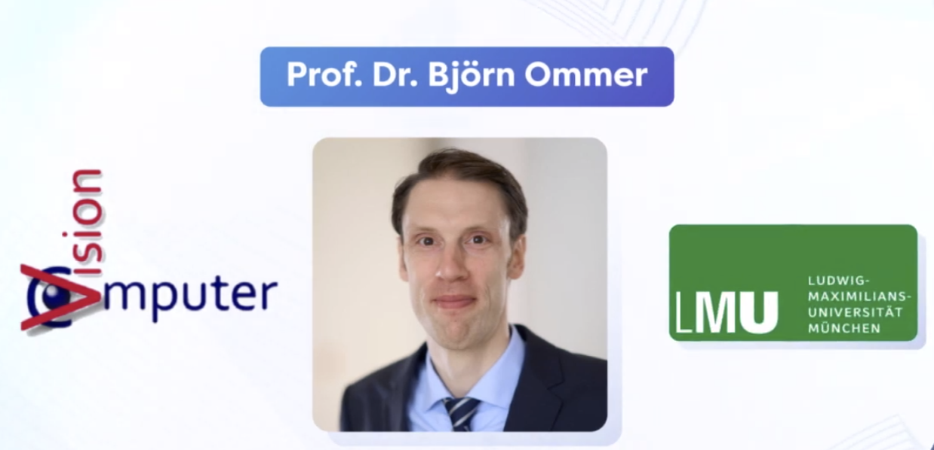
History of Stable Diffusion
LDM
LDM Development as supported by Dr. Bjorn’s students :
Stable Diffusion was based on:
Latent Diffusion Model(LDM) Process
LDM was developed by Comp-Vis Lab’s Prof. Dr. Bjorn Ommer at LMU, Germany.

Slide 7

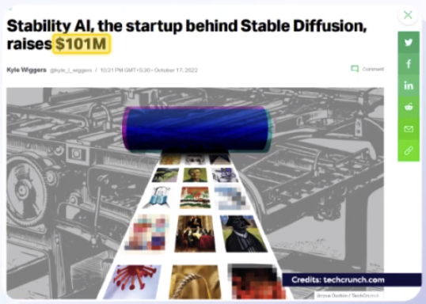
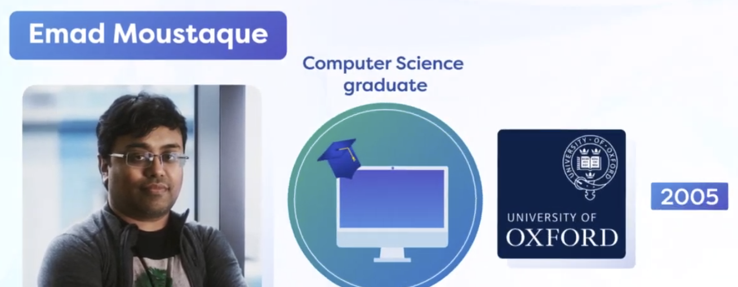
History of Stable Diffusion
Stability.AI’s Stable Diffusion
Aug,2022 release of SD, helped raise 101M USD in OCT,2022!
Stable Diffusion released by Stability.AI released had 3 important features needed for community research and development process :
Open Source Code Fast to Train and Fine-tune Capable on running Consumer GPUs
Research and development at the expense of 600k USD was released to public.
Ignited the great Text-Image-Movement.
Stability.AI was founder by Emad, who was Hedge Fund Manager for 13 years.

Slide 8
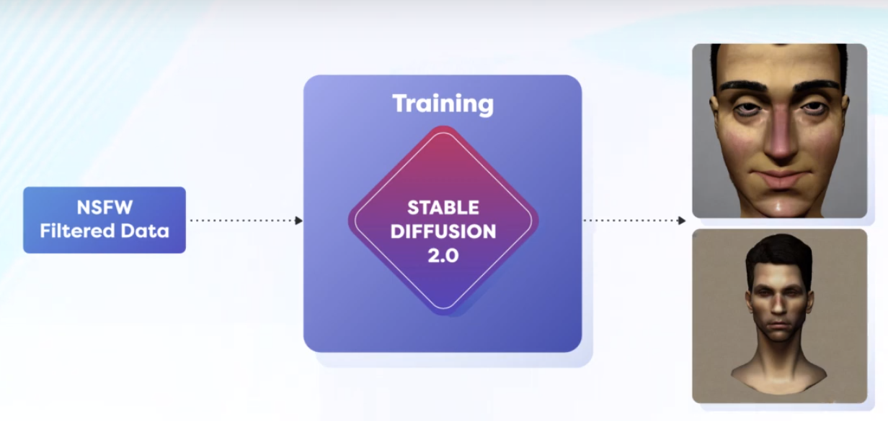
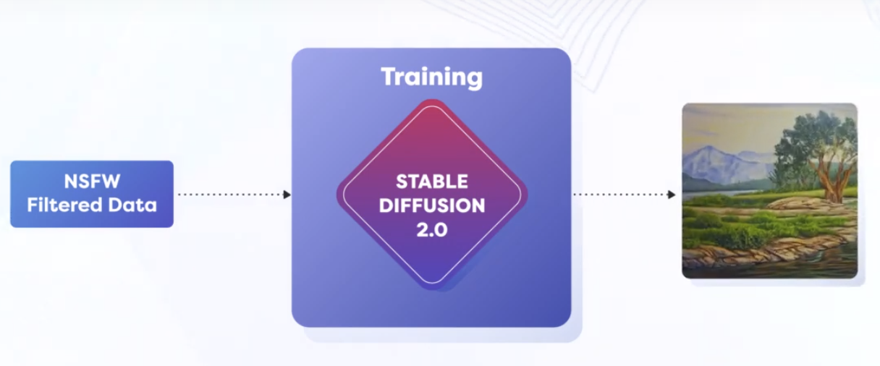
History of Stable Diffusion
Stable Diffusion 2.0: Nov, 2022
Stable Diffusion 2.0 was with:
Content Moderation, No NSFW data New Text Encoder: OpenCLIP
Removal of NSFW data caused limitation of face generations.
But was much better at non-human body like artifacts.
These limitations were addressed in v2.1

Slide 9
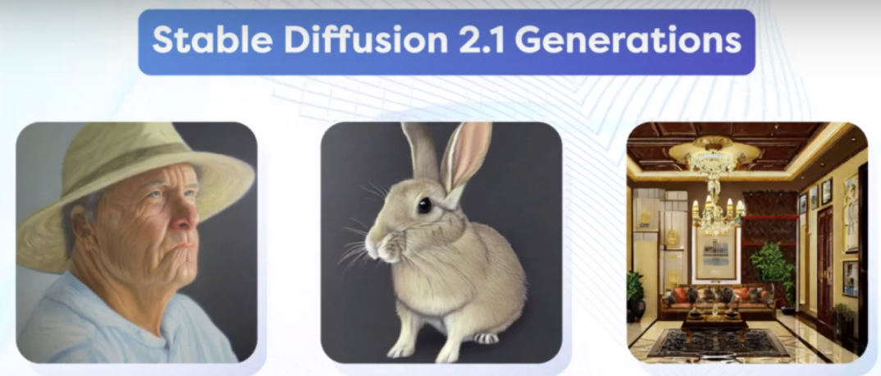
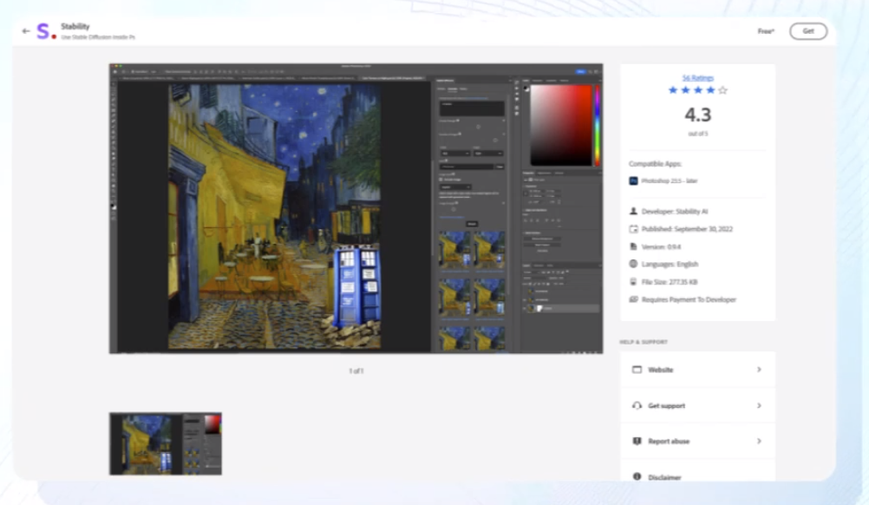
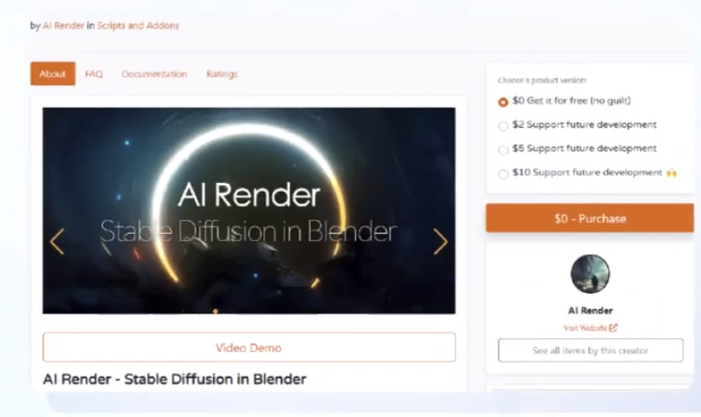
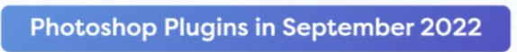

History of Stable Diffusion
Stable Diffusion 2.1
Stable Diffusion 2.1 was Actually First Awesome version as we know it today.
Human faces were very high detailed Lighting and Contrast was much better.
Soon Plugins for 2 most important Image editors were released:
These plugins have boosted the adoption as unimaginable speed by Artists and Non-tech Community.

Slide 10
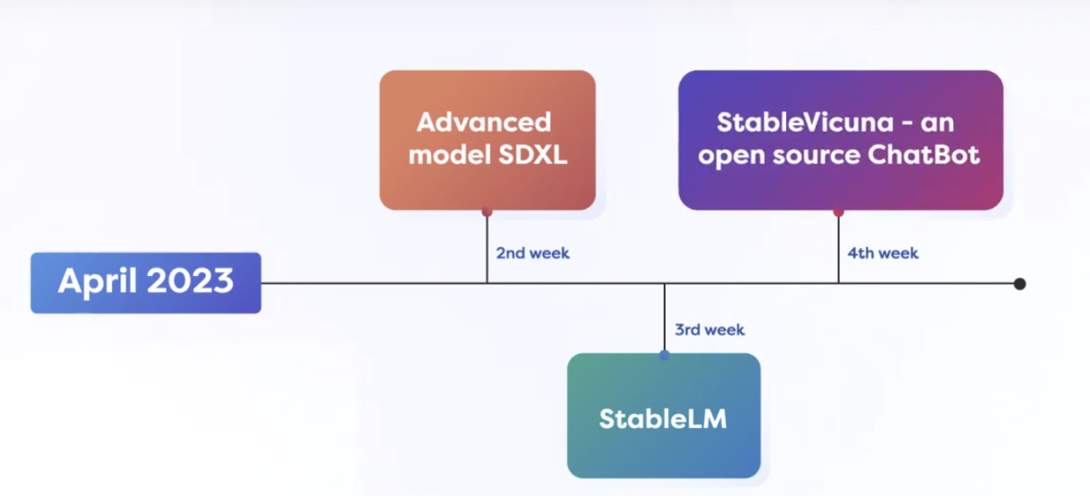
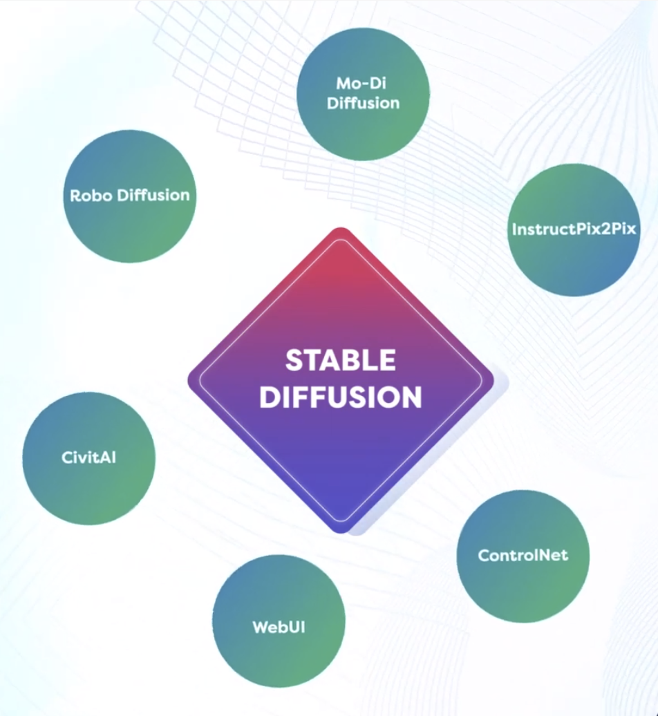
History of Stable Diffusion
Blockbuster SD Month: Apr, 2023
These releases opened the floodgates of new research on top of SD as:
3 Major releases of SD:
Advanced SDXL StableLM - LLM, not a Image model StableVicuna - Chatbot
Fun Fact: Stability.AI funded first A100 GPU for MidJouney’s Development, A Healthy Competition.

Slide 11
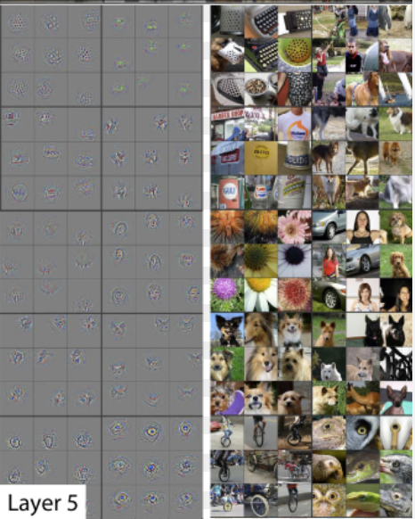
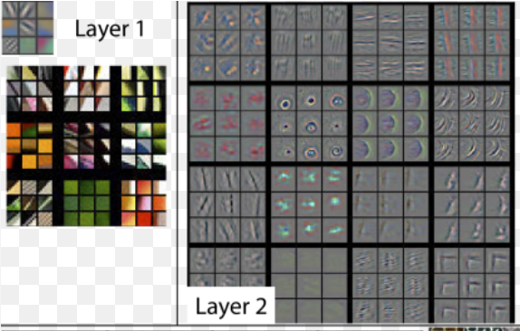
Before moving on to Stable Diffusion
Fergus & Zeiler paper https://arxiv.org/abs/1311.2901
Very first public explanation of gradients abstraction building understanding in more visual form.

Slide 12
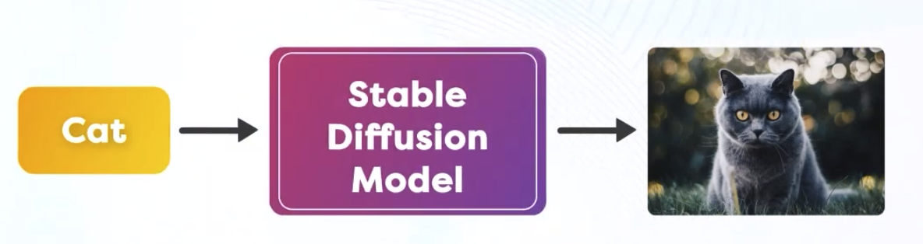
Stable Diffusion: Intuition
Stable Diffusion model we enter Text and it generates Images.
But it does NOT convert Text to Image
Instead, It Converts Noise into Image
By the guidance of Text by performing Reverse Diffusion.
Three Terminologies here are:
Noise into Image
Guidance of Text
Reverse Diffusion
Stable Diffusion is Multi-Model, which Understand Text and Images both.

Slide 13
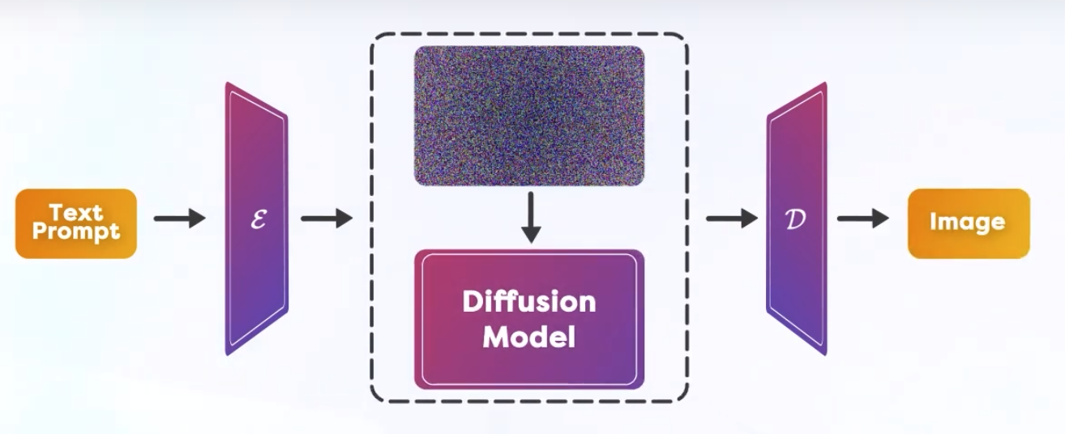
Stable Diffusion: Intuition(contd.)
Reverse Diffusion
Text prompt guides, how to alter the Noisy Image so that:
“Altered Noisy Image looks like little bit more like Description as in Text”
Lets see an example of this intuition.

Slide 14
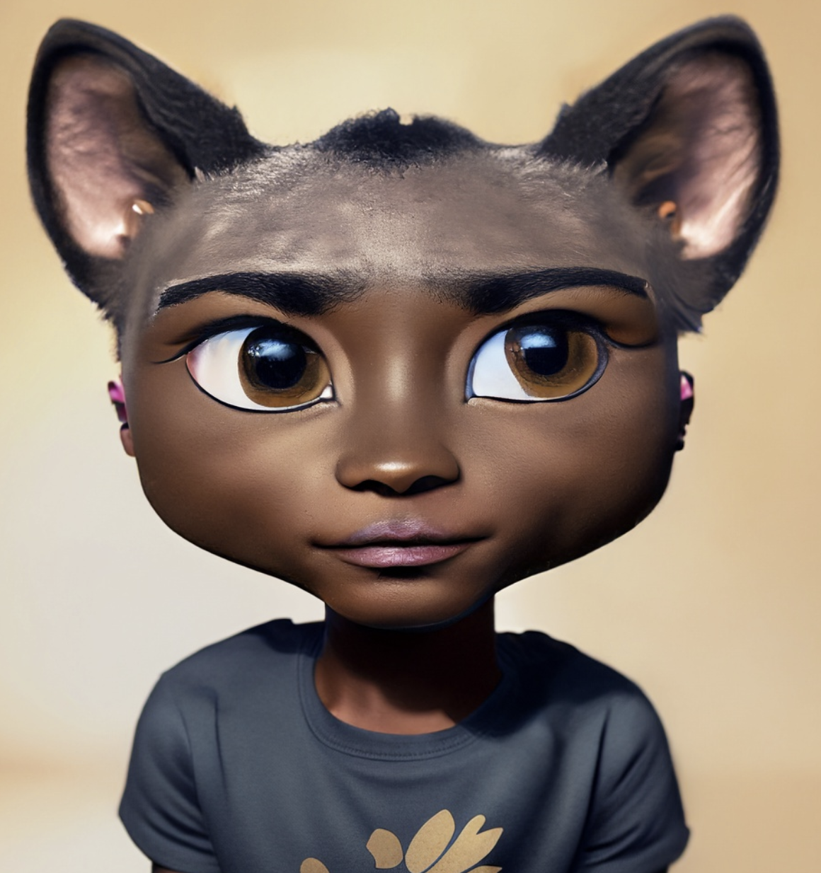
Stable Diffusion: Intuition - Guidance
For the Input Text “Boy”, we have image generated as here.
What is wrong with Image of Boy?
Ears and Head needs to change.
So, Text “Boy” guides you to change “ears”.
In Stable Diffusion, This guidance is at Pixel level.
Text in encoded form telling us which pixels needs to change by slight amount.

Slide 15
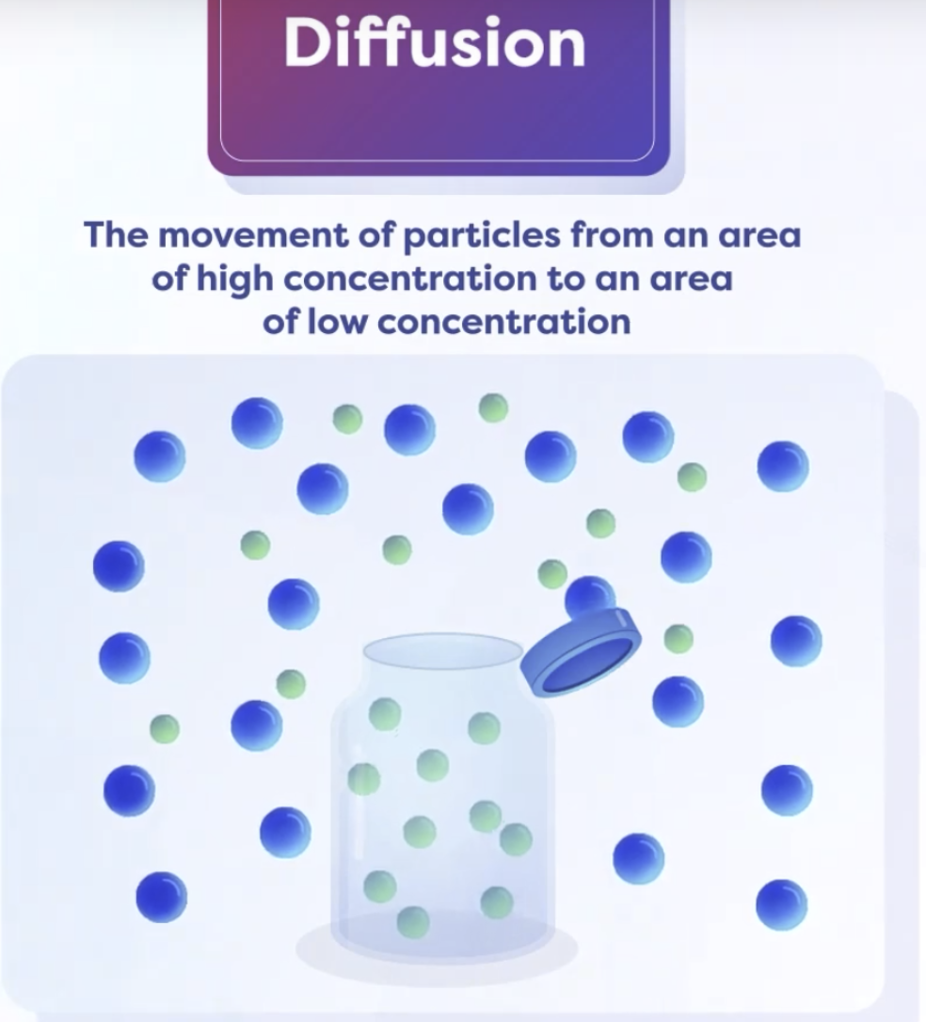
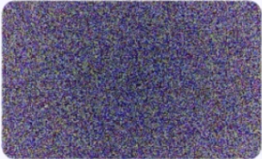
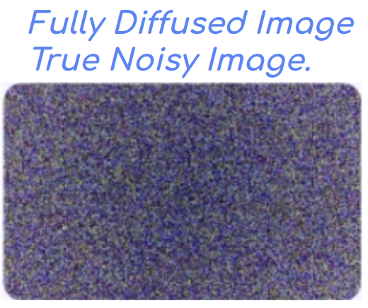
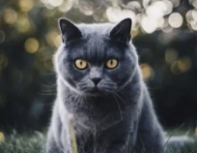
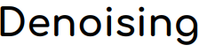
Stable Diffusion: Intuition
Reverse Diffusion
First, What is Diffusion?
molecules move from an area of higher concentration to an area of lower concentration to achieve equilibrium.
This diffused state in Images can be imagined as: True Noisy Image.
After fully reverting this diffusion of noise, we construct: Image described by Text.
So, Reverse Diffusion is: Change pixels of Noisy Image a bit, So that it looks more like Text Input.
Reverse Diffusion is called: “Denoising”
Fully Diffused Image True Noisy Image.
Cat: After many Reverse Diffusions

Slide 16
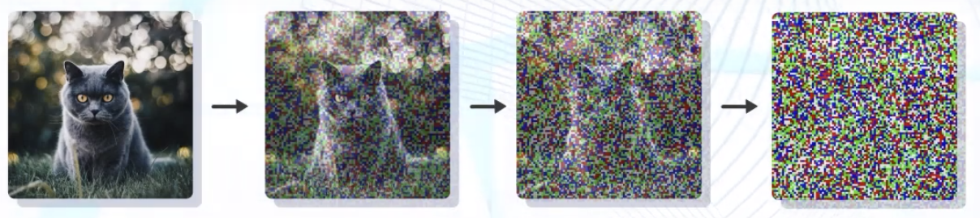
Stable Diffusion: Intuition
Forward Diffusion
X₀ X₁ X₂ ……… X_{T}
Reverse Diffusion
Forward Diffusion is Noising
Reverse Diffusion is Denoising
Note: X₀ is Denoised Image, X_{T} is Image with added Noise T times.

Slide 17
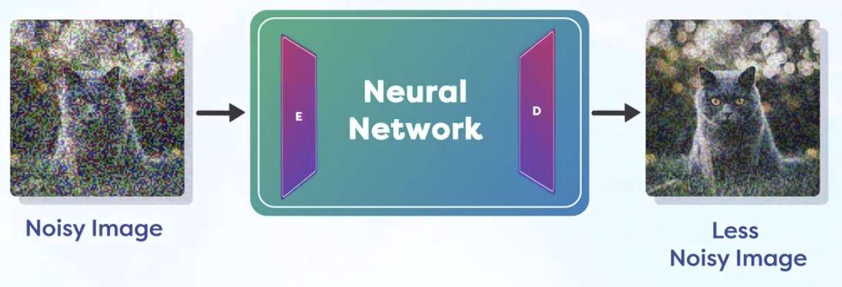
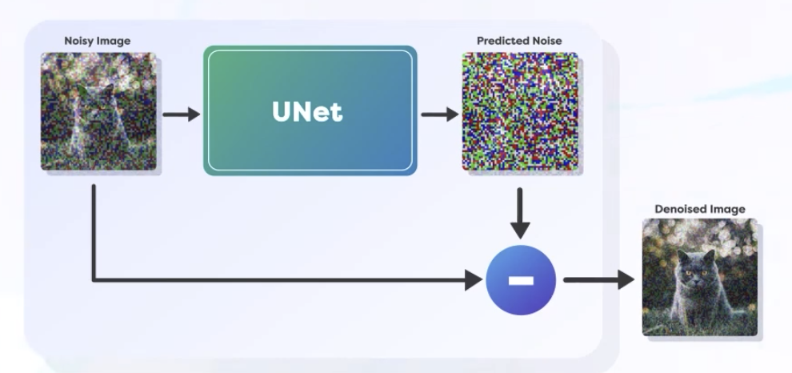
Stable Diffusion: Purpose
At Every Step of Reverse Diffusion, We want to:
Calculate the Noise on Current Image
Remove the Noise from Current Image
Repeat
So, Stable Diffusion is:
C ⇒ R ⇒ R
Noise is calculated easily with Neural Networks, Unet is popular network for the same. UNet?? WTH??
We cannot estimate all the error in one step, we do it slowly and Diffusion Process remains “Stable”. Too fast and big of change causes “Instability”.

Slide 18
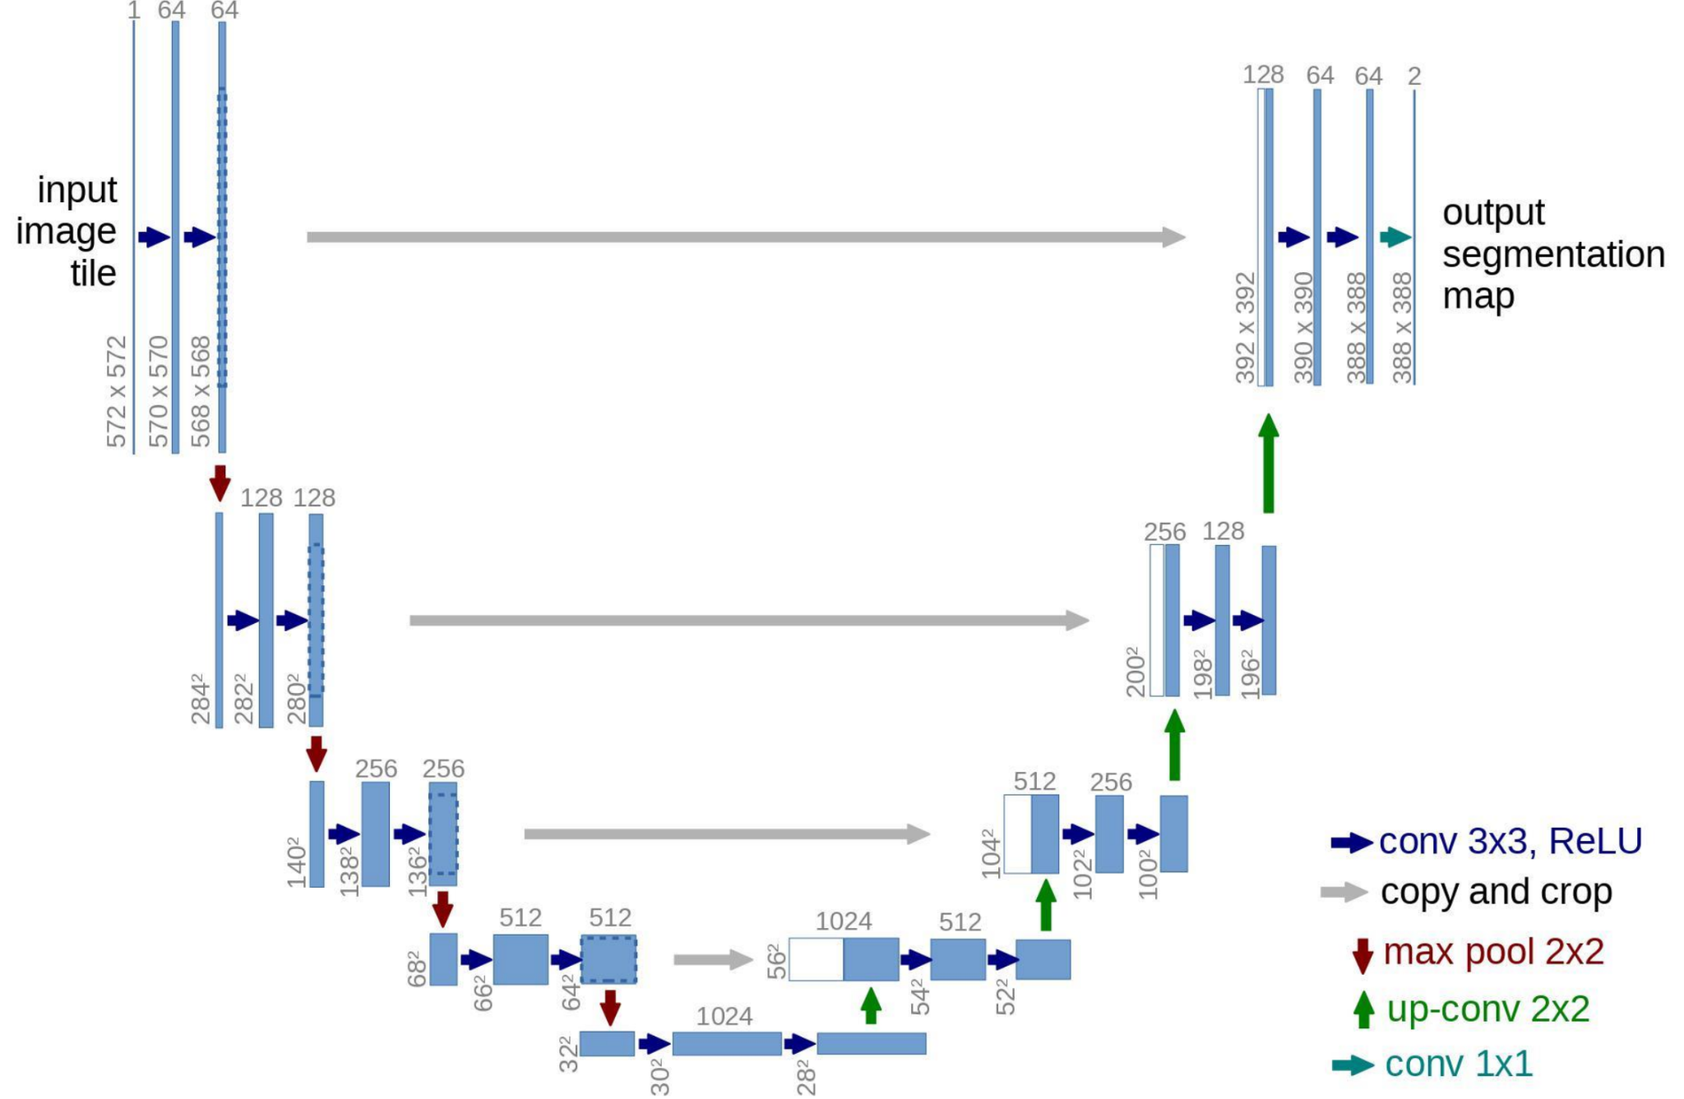
Stable Diffusion: A bit about UNet
Originally envisioned for Medical Image Segmentation tasks, but repurposed heavily for many image-2-image tasks.
Have Convolutional Encoder(Down-sampling) and Decoder(Up-sampling) parts.
Learns Modulations at Multi-Scale and Multi-Abstraction Levels.
Lateral Skip Connections are the Secret sauce compared to VAE. (Just remember that for now)

Slide 19
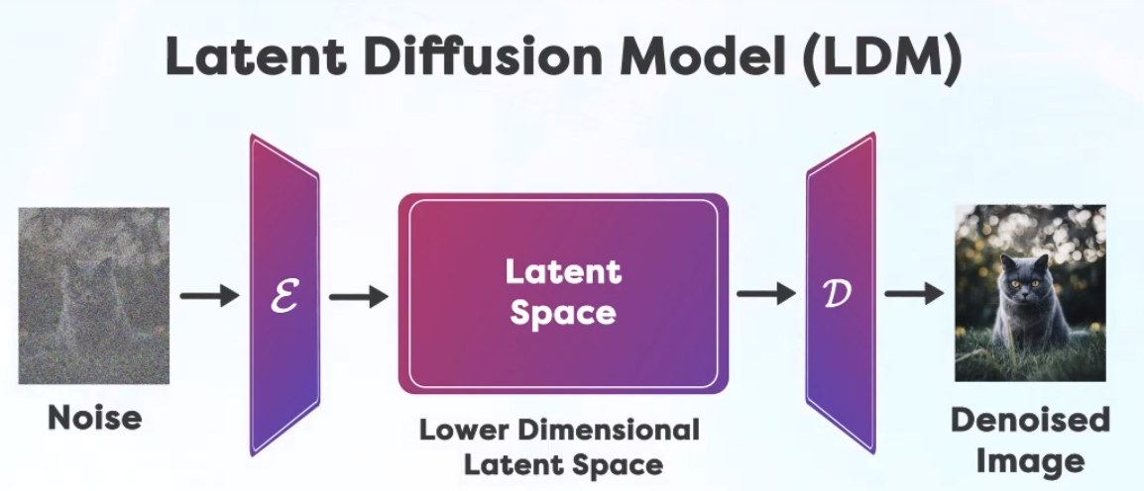
Stable Diffusion: Now Latents
Stable Diffusion needs to perform very small amount of changes during Denoising to Keep Denoising Stable. So:
Diffusion is Slow, Takes Long Time
To Speedup the Diffusion Process:
We Reduce the side of Starting Noisy Image.
This reducing of Starting Image is: Encoded into Latent Space
Denoising is performed on Latents.
Denoised Latents are: Decoded from Latent Space
Decoder outputs the Final Image
So, Stable Diffusion works on Encode Image into Latent Space.
This is done purely to Speed-up the Denoising Process.
There are other models, which work directly on original Image as Google’s Imagen.

Slide 20
Stable Diffusion:
Latents Stable Diffusion
We now we understand: Latent: Encoded Inputs, Decoded Outputs Stable: Small Changes to Denoise Diffusion: Denoising

Slide 21
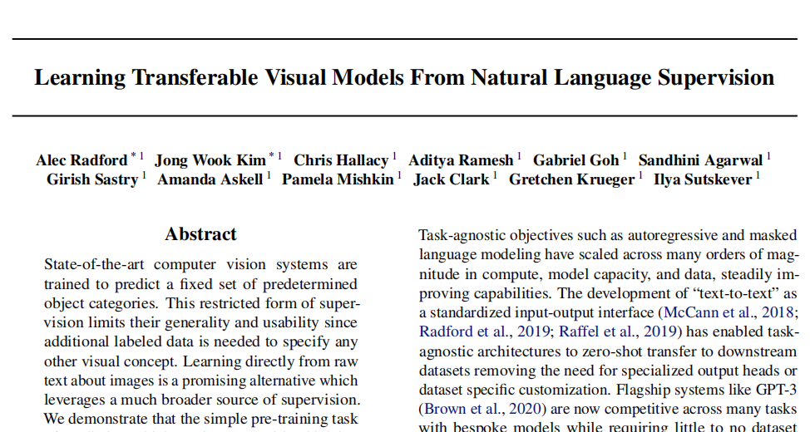
Stable Diffusion: What About Text?
How do we take Guidance from Text to Calculate Noise?
Text is Encoded into Latent Space as well. But it is Text’s it's Own Latent Space.
This Process of Interaction between Image and Text in Latent Space is the Foundation of all the text to image models.
This phenomenon has blurred the lines between text and Image Models.
And it all Started with:
CLIP Paper in Jan 2021
Let us Understand CLIP.

Slide 22
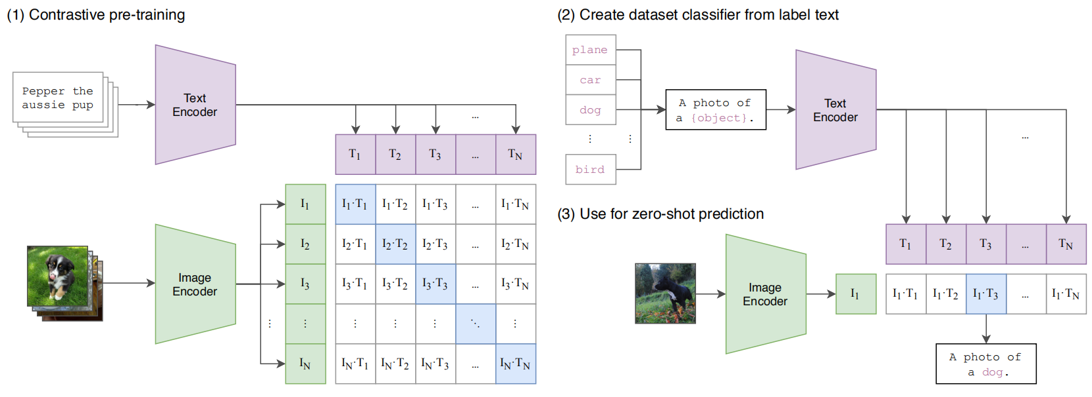
Stable Diffusion: CLIP
CLIP(Contrastive Language–Image Pre-training) paper: https://arxiv.org/abs/2103.00020
CLIP jointly trains an image encoder and a text encoder to predict the correct pairings
In Simple language this paper meant to say: Train a Model using “Image - Caption” pairs, So, Captions for similar images will have Embeddings nearby in Latent Space.

Slide 23
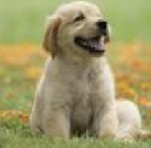
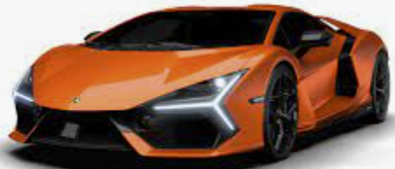
Stable Diffusion: CLIP Intuition
Whole CLIP Paper is: The CLIP model consists of a text and an image encoder which encodes textual and visual information into a multimodal embedding space. Now, the aim of the model is to increase the cosine similarity score of images and text which is actually associated.
CLIP Trained Models, Helps us: Encode Texts and Image In A way Where Text and Image Embeddings With similar meanings Are Nearby in Vector Space.
While Encoded Text embeddings for “dog” or “puppy” will be MORE cosine similar to the Encoded Image as below:
But Encoded Text embeddings for “dog” or “puppy” will be LESS cosine similar to the Encoded Image as below:
Quantity which is more for not-matching Text and Image and less for matching Text and Image is called: “Contrastive Loss”

Slide 24

Stable Diffusion: CLIP Intuition

Slide 25
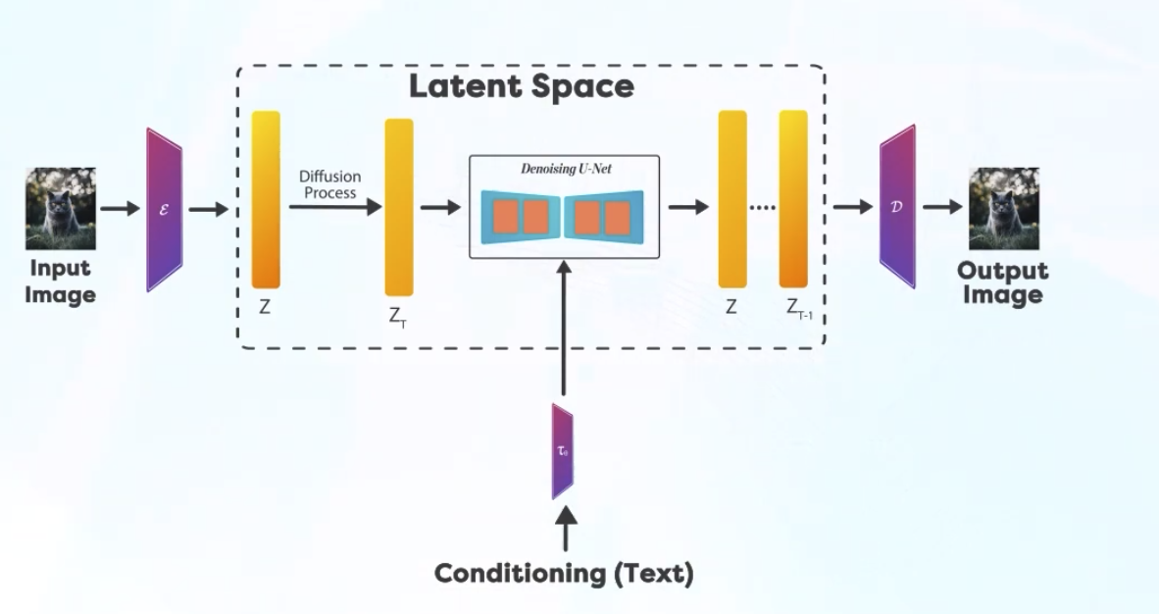
Stable Diffusion: How it all Fits In?
We know which Texts are similar if they have similar Embeddings, i.e. They means similar concepts.
We use this concept to Train Denoising UNet in latent Space, where we know the amount of noise added at scheduled times. Explain!
Once trained, We can calculate noise in any image given Encoded Text is given.
Encoder and Decoder are part of Variational Autoencoder (VAE), which we will see in a bit.
Just get the Idea if it is not falling in place in mind.
Just what you know, And do not worry about what you don’t!
We will get to it many many times.
But, WTH with mage above? Simple English?

Slide 26
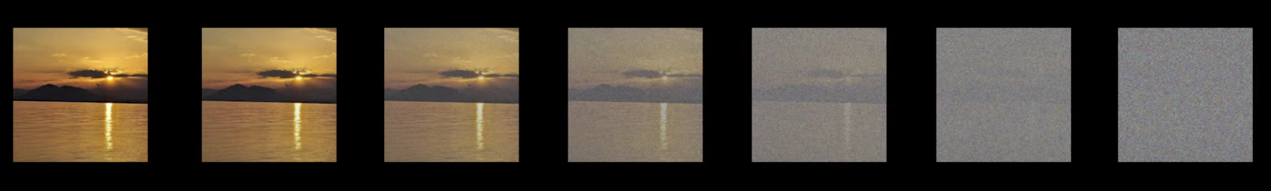


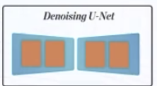
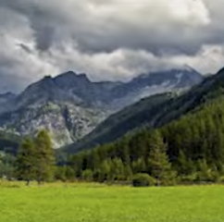
Stable Diffusion: How it all Fits In?
Training: We add noise by known amount and try to denoise it as per text. Do it Millions of times.
Inference: We just reduce noise from random noise slowly as per text. Keep doing it until denoised image is as expected.
This process is Called: DDPM: Denoising Diffusion Probabilistic Model.
DDPM Paper Link: https://arxiv.org/abs/2006.11239
Training
Inference

Slide 27

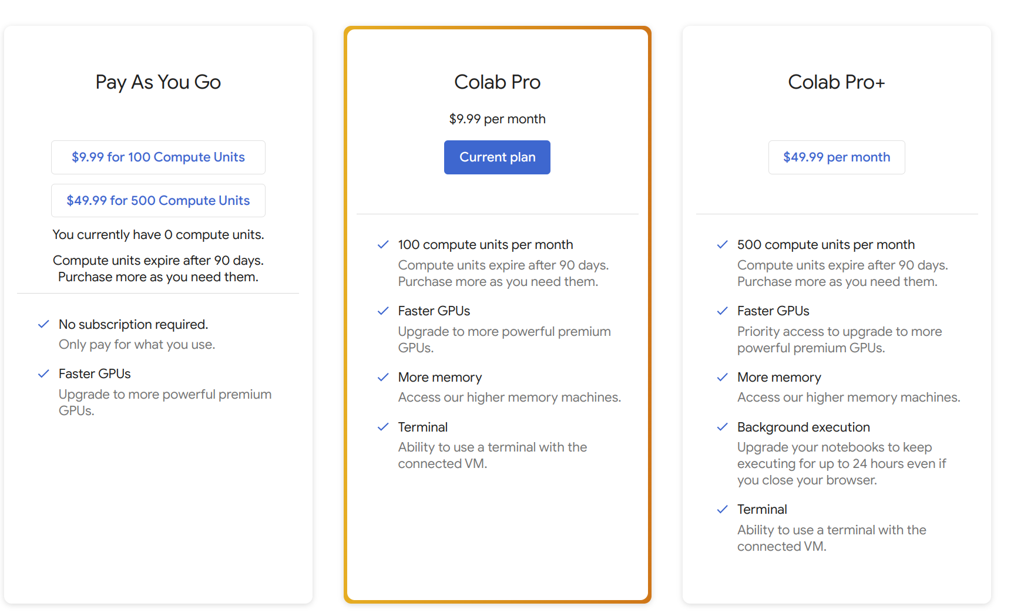
Runtime Environments: Google Colab
Access: https://colab.research.google.com/
Pros:
Instantly available.
Notebook Friendly
Cons:
Short Lived.
Data needs to restaged. Not viable for Long running jobs
When to use: Just to try somebody else code. To understand or Clarify concepts.

Slide 28

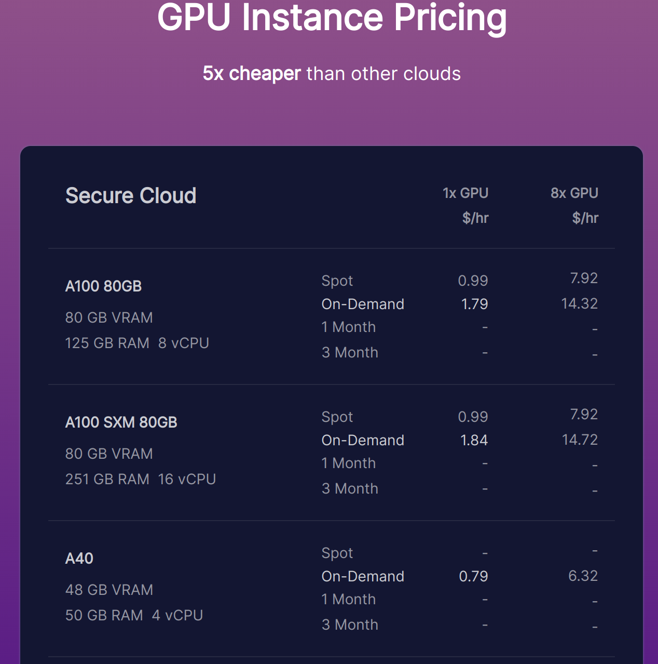
Runtime Environments: RunPod.io
Access: https://www.runpod.io/
Pros:
Mostly Instantly available.
Notebook and VS Code Friendly.
Fairly Priced.
Cons:
Long Lived.
Persistent Storage Provided. Viable for Long running jobs
When to use: Almost Always, when not pricey. For Long running intense jobs.

Slide 29




Runtime Environments: Many Others

Slide 30
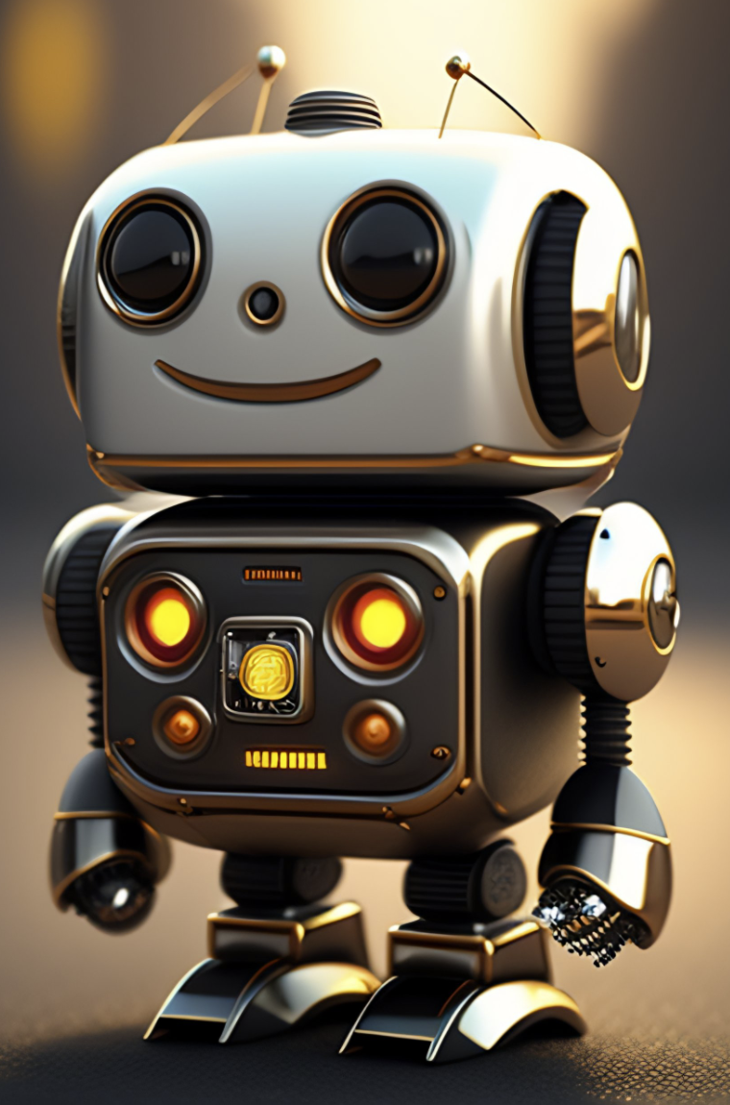
Questions?

Slide 31



